Slide 1
Regression Analysis
- By Indrani and Jayanta

Slide 2
Learning Objectives
Regression Modelling Steps
Learn some Terminologies Related to Machine Learning
Explain the Linear Regression Model
Implement the Linear Regression Model in Python by understanding the Mathematical Model Involved
Describe Various Different Types of Regression Models
To solve a Real Time Use case Based on the Session

Slide 3
Regression Modelling Steps
Define problem or question
Specify model
Collect data
Do descriptive data analysis
Estimate unknown parameters
Evaluate model
Use model for prediction

Slide 4
Terminologies Related to Machine Learning
Dependent Variables
Independent Variables
Outliers
Multi-Collinearity
Underfitting and Overfitting

Slide 5
Goal Of Regression Analysis
Statistical Model to find a relationship between Dependent and Independent variables.
Example – Suppose I want to predict that for a person who has approximately 18 years experience, how much will be his salary?
No of Years of Experience (Independent Variable) | Average Salary (Dependent Variable)
2 | 10 lpa
4 | 14 lpa
7 | 18 lpa
25 | 40 lpa
10 | 22 lpa
18 | ???

Slide 6
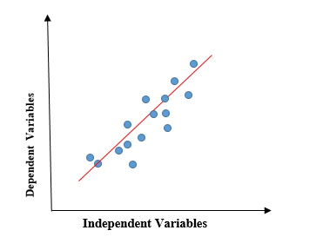
Linear Regression
Linear Model that assumes a linear relationship between the input variables (x) and the single output variable (y)
If Number of Input Variables (x) is-
Single Input Variable – Simple Linear Regression
Multiple Input Variables – Multiple Linear Regression
Mathetical Equation for Linear Regression
y = mX + c + e
[y = Dependent Variable,
X = Independent Variable,
m = slope [defines the type of relation] ,
c = constant when X = 0
e = Error]

Slide 7
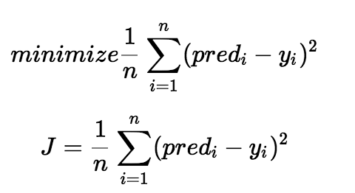
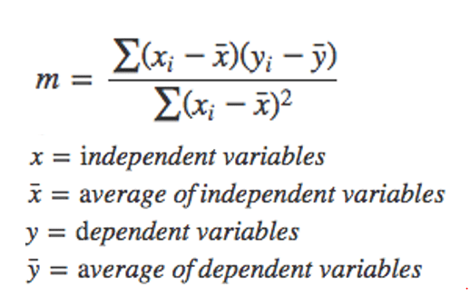
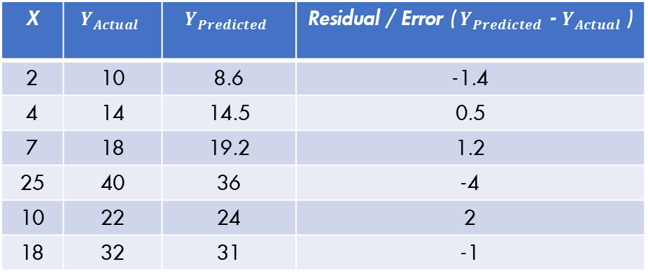
Simple Linear Regression
Objective – To choose the values for m and c in such a way that we can minimize the error between the actual value and the predicted value
How to Minimize Error and Find the Best Fit Line?
a) Finding A cost function (Mean Squared Error)
And Applying an Algorithm called – Gradient Descent
b) Ordinary Least Square
X | $$Y_{Actual}$$ | $$Y_{Predicted}$$ | Residual / Error ( $Y_{Predicted}$ - $Y_{Actual}$ )
2 | 10 | 8.6 | -1.4
4 | 14 | 14.5 | 0.5
7 | 18 | 19.2 | 1.2
25 | 40 | 36 | -4
10 | 22 | 24 | 2
18 | 32 | 31 | -1

Slide 8
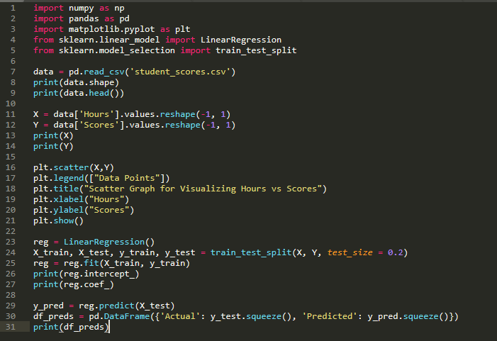
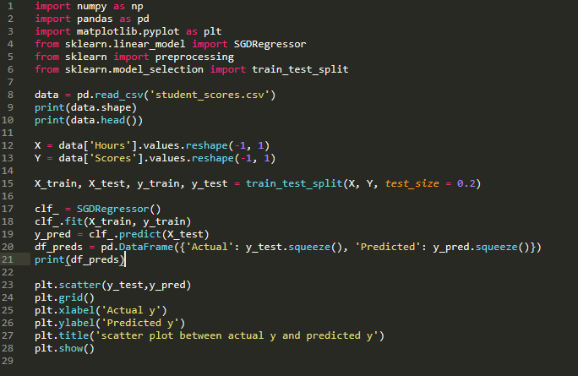
Python Implementation of SLR
The Linear Regression Coefficients can be found in 2 ways-
Using Ordinary Least Square
Using Gradient Descent
LinearRegression() in scikit Learn uses OLS Method
SGDRegressor() in scikit Learn uses Gradient Descent

Slide 9


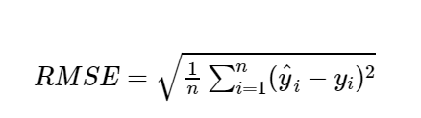
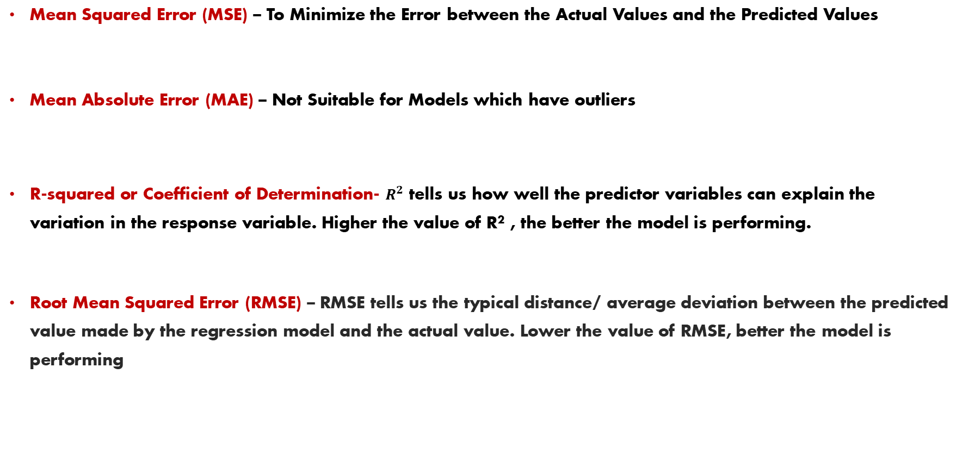
Evaluation Metrics of a LR Model
Mean Squared Error (MSE) – To Minimize the Error between the Actual Values and the Predicted Values
Mean Absolute Error (MAE) – Not Suitable for Models which have outliers
R-squared or Coefficient of Determination- $R^{2}$ tells us how well the predictor variables can explain the variation in the response variable. Higher the value of R² , the better the model is performing.
Root Mean Squared Error (RMSE) – RMSE tells us the typical distance/ average deviation between the predicted value made by the regression model and the actual value. Lower the value of RMSE, better the model is performing

Slide 10
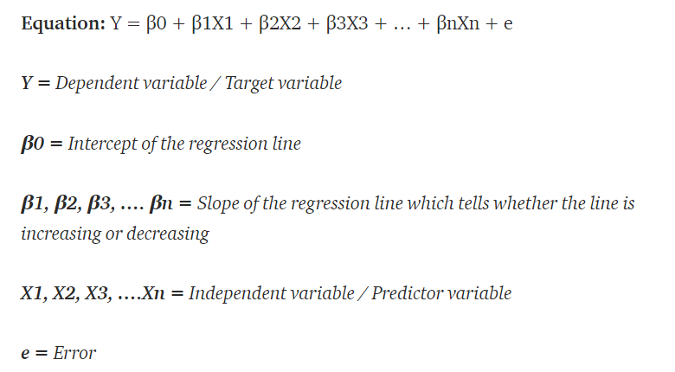
Multiple Linear Regression
A multiple linear regression model can analyze the relationship between several independent variables and a single dependent variable.

Slide 11
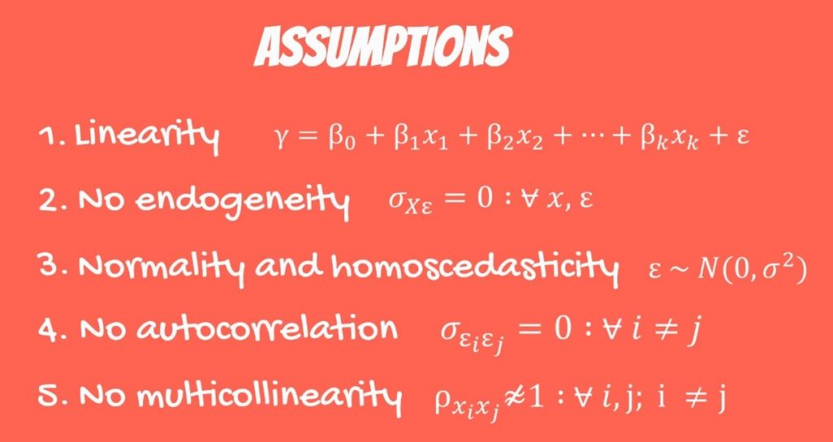
OLS Assumptions
Assumption 1 – The Assumption of Linearity
Assumption 2 - Endogeneity of regressors
Assumption 3 - Normality and Homoscedasticity of the Error term
Assumption 4 - No autocorrelation
Assumption 5 - No multicollinearity

Slide 12
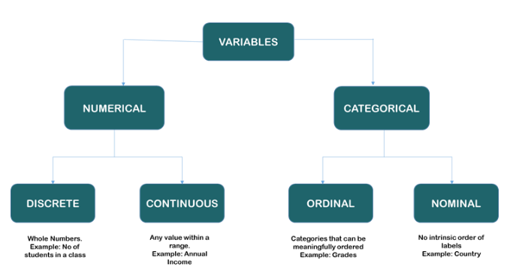
Data Pre-Processing
Step 1- Variable Identification – The first step in Exploratory Data Analysis is the identification of type of Variable in your Data set.
Step 2- Identification of Independent and Dependent Variable – The next important step is to identify what are the Predictors(input) and what is the Target(Output) Variable.

Slide 13
Step 3- Handle Missing Values in your Dataset
If the percentage of missing values in each column is very less – Drop The Observation
If the percentage of Missing Values in each column is significantly high and the feature is not important – Drop the Feature
OR
If a Numerical Column has missing Values , then Replace those with the Median Value of that column.
If a Categorical Column has missing Values, then Replace those with the Mode Value of that column.
Step 4- Handle Outliers in your Dataset
If your Dataset is Small -> You can visualize the Data and Identify the Outliers
If Your Dataset is Huge ->
Detection of Outliers Using Z Score
How to Handle those Outliers?
Remove the Outliers – Bad Practice
Replace the Outlier Value with the Median of the Column – Why not Replace it with Mean?

Slide 14
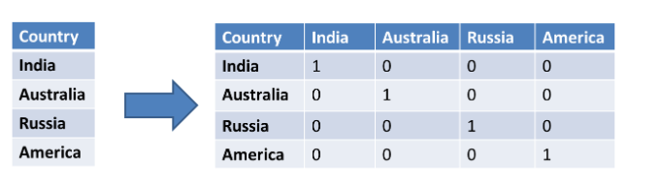
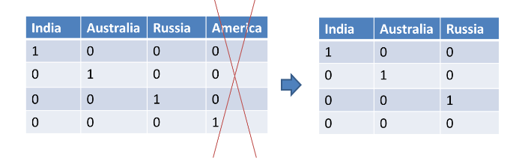
Step 5- Handling categorical variables with one-hot encoding - Converting categorical features to numerical features by using one-hot encoding.
For Each Categorical Feature, create a New Dummy Variable
Map the newly Created Variables with binary values either 0 or 1 based on the features
To Avoid Dummy Variable Trap -> If we have n categories, we create n-1 features. So, we will Drop 1 Newly Created Variable.
If the Value for All the 3 columns “India”, “Australia” and “Russia” are 0 , it means that the country is America

Slide 15
Step 6- Dimensionality Reduction : a) Feature Selection: Reducing the dimensionality to a subset of the original dataset by dropping variables that hold little information. b) Feature Extraction: Combining features by identifying key information within each variable to create new features. Why we need to do Dimensionality Reduction in Linear Regression Analysis? 1. To Control Overfitting 2. To Reduce Multi-collinearity 3. To combat Computational Costs 4. To Interpret High Dimensional Data sets Step 7- Renaming Feature Names and Changing the Data Type of some variables EXERCISE – You have been Provided with a Dataset “ 50_Startups“ . Perform Steps 1-5 and 7 on the Data wherever applicable using Python and Implement a Multiple Linear Regression Model to predict “Profit”.

Slide 16
Data Repository Sources and Hands On Session
Kaggle
UCI Repository
EXERCISE:
You have been provided with a Dataset on USA Housing. Process the Data and train it for prediction of House prices based on your Selected Features.
I want you to predict the price for a house whose:
Average Area Income is – 45546.2
Avg. Area House Age is – 2 years
Avg. Area number of Rooms is – 4
Avg. Area Number of Bedrooms – 3
Area Population – 75425.98726
Address – 192 RPA Views Suite 025 , Lake Katherine, CA 48958

